Slide 1
Gesture Droid Computer Science Project Endreport
Christoph Fuchs
Roman Hochstöger

Slide 2
Motivation

Slide 3
Content
Introduction & Motivation
Used Hardware
Software
Server program
Evaluation of measured data
Problems
Conclusions

Slide 4
Introduction
Movement of
Smartphone
Wii-Remote
Transmission of data to the server program
Analysis of movement data
Comparison of Wii-Remote and smartphone data

Slide 5
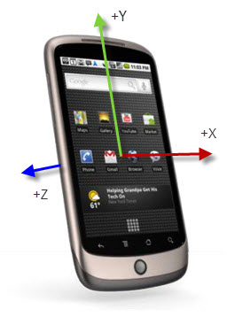
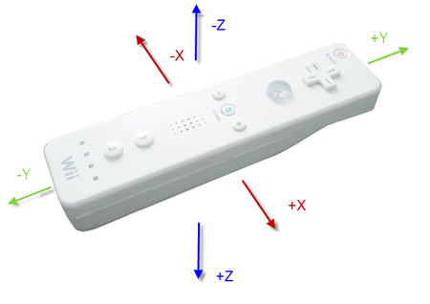
Hardware
Smartphone
HTC N1 & HTC DESIRE
Wii-Remote

Slide 6
Gestures
Test data from multiple similar movements
TODO examples
Restricted movement
Velocity
… TODO

Slide 7
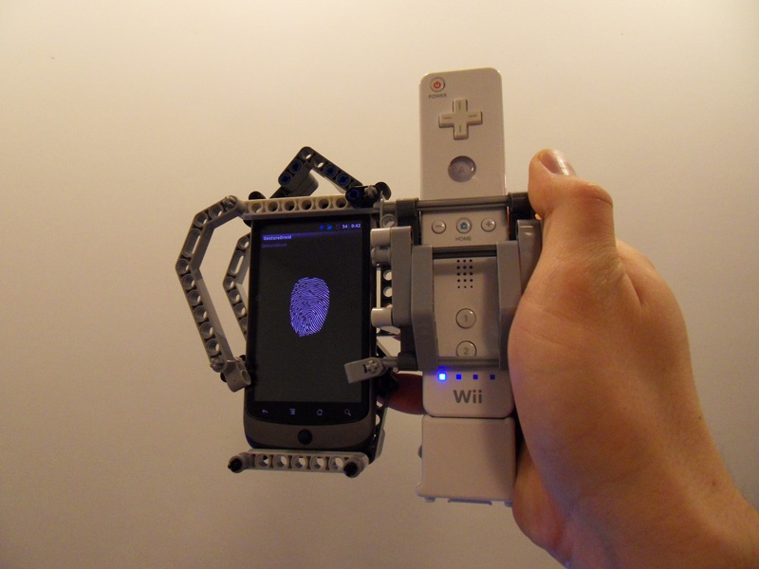
Mounting Device

Slide 8
Software
TODO Overview Figure

Slide 9
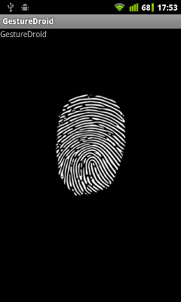
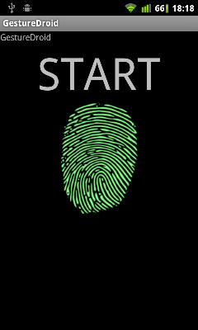
GestureDroid (Android-App)
Read the sensors
Transmission of data to the server programm via TCP

Slide 10
Server Program (Java):
Connection via
TCP (Smartphone)
Bluetooth (Wii-Remote)
Visualization of the position
Check of data connection

Slide 11
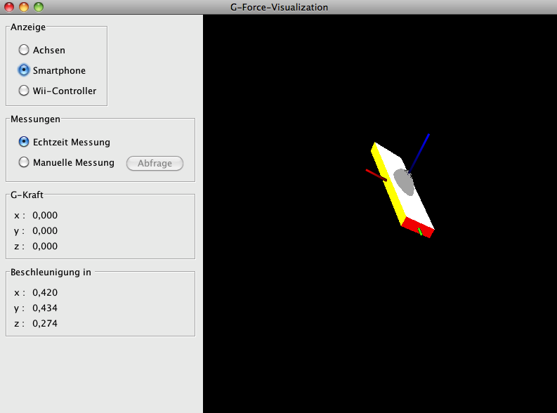
Server Program

Slide 12
MATLAB Program
Multiple executions of one gesture
Validation of testdata
Different gestures
Feasibility of classification
Different hardware
Comparison of sensordata

Slide 13
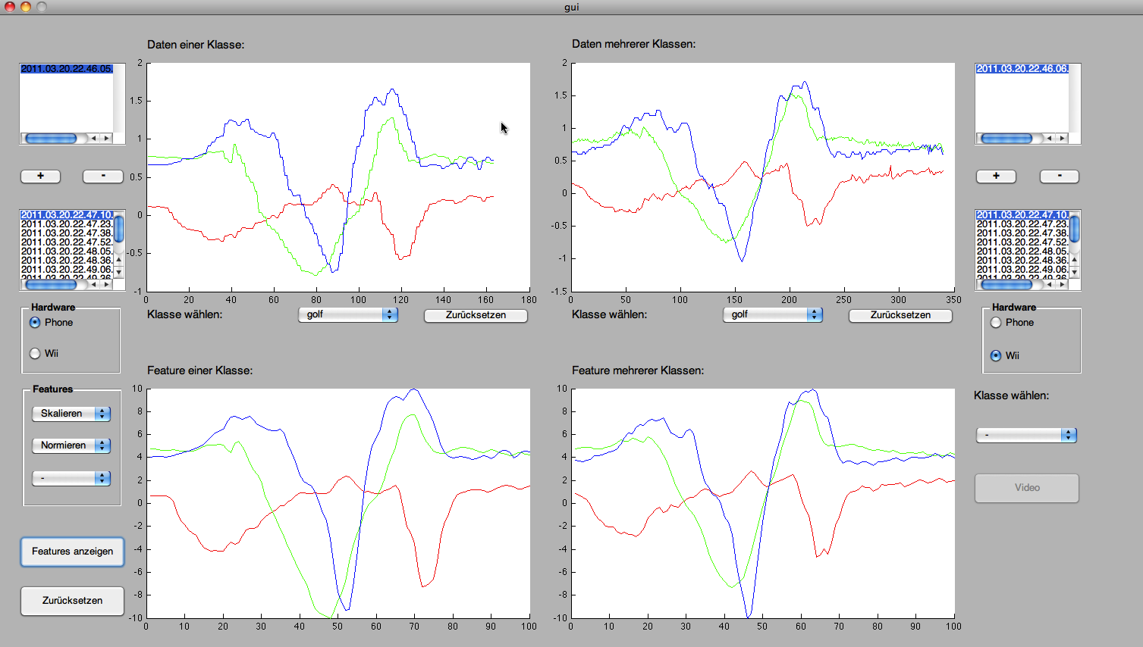
MATLAB Program

Slide 14
Results

Slide 15
Problems
Evaluation of the orientation sensor
Orientation is calculated by acceleration
Determination of orientation in space
Data connection between Wii and PC
Driver problems in Windows
Measurement range of smartphones
Movement velocity has not to be over 2g

Slide 16
Conclusions
Orientation of smartphones in space during movement is difficult to determine
Acceleration sensors of Wii-Remote and Smartphones deliver similar messure data
Choice of classification algorithm not obvious
Wii games do not perform classification
Newer hardware also uses Gyroscopes

